Slide 1
Solving Problem with Metrics for Data Analyst
By: Muhammad Mahardhika Herdiman

Slide 2
Seoul Sweets Problem Statement
Seoul Sweets recently launched an online platform and delivery service, but the company does not yet fully understand customer behavior when navigating their website.
Based on the activity data from the first 10 users, it was found that:
Many users viewed products, but not all completed the payment process.
There is a noticeable drop-off at each stage of the funnel.
The biggest drop occurs between the Delivery Info → Confirm Payment stages.
Main Problem:
The online purchase conversion rate is still low because many customers abandon the process before completing payment.
Business Impact:
Online sales are not fully optimized.
The customer journey is not efficient.
There is significant potential revenue loss.

Slide 3
Funnel Chart for Customer Journey
Step 1 — Create a Pivot Table
Rows → Stage
Values → Count of User ID → Sort by User → Sequence Downward
Step 2 — Insert The Funnel Visualization
→ Add an Empty Column between The Stage and User Columns titled Helper (B1)
→ in B2 use The Formula =(MAX(C2:C5)-C2)/2
→ Click AutoFill
→ Select the data
→ Click insert
→ Chart
→ Edit Chart
→ Bar Chart
→ Customize
→ Series
→ Change the Opacity Option in the Helper to 0%
→ Change to The User and click the Check on the Data Labels Box
→ Legend
→ Pick None on The Position
→ Gridlines and Ticks
→ Uncheck The Major Gridlines Box

Slide 4
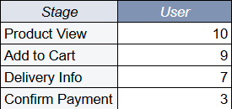
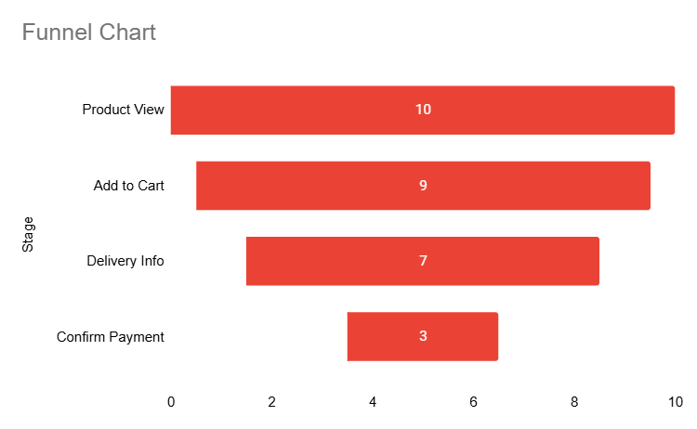
Funnel Chart of Customer Journey Overview

Slide 5
Funnel Insight
Biggest Drop-off:
From Delivery Info (7 users)
To Confirm Payment (3 users)
This indicates that many customers abandon the checkout process before making payment.
Possible Causes:
Delivery fees are too expensive
Limited payment methods
Complicated checkout process
Lack of trust in the platform

Slide 6
Actionable Metric
Checkout Conversion Rate
Formula:
Confirm Payment/Product View×100%
Calculation:
3/10×100%=30%
Result:
Conversion Rate = 30%
This is considered an actionable metric because it can be improved by:
simplifying the checkout process
adding more payment methods
offering free delivery promotions
improving website UX/UI

Slide 7
Vanity Metric
Total Product Views = 10
Reason:
A high number of views does not necessarily generate sales.
It does not directly help decision-making for business improvement.

Slide 8
Opinion About the Customer Journey
The customer journey at Seoul Sweets is fairly good in the early stages because:
90% of users added products to their cart.
This indicates that the products are attractive to customers.
However, the funnel is still ineffective at the final checkout stage because:
only 30% of users completed the payment process.
Conclusion:
Seoul Sweets has:
Strong Product Attractiveness
But a weak Checkout Experience
Recommendations:
Simplify the checkout process
Add more payment options
Offer free shipping or delivery promotions
Add trust-building elements such as:
Customer Reviews
Secure payment badges
A clear Delivery Estimates
If these improvements are implemented, The Conversion rate could increase significantly.

